Slide 1


terraform
BJ Dela Cruz, CISSP
Software Development Branch 3

Slide 2

agenda
What is Terraform, and what are its benefits?
The components of a Terraform configuration
Providers, resources, data sources, input variables, outputs, modules
How does Terraform keep track of changes to your infrastructure?
Terraform commands: init, validate, plan, apply, and destroy
Examples of using Terraform to provision AWS and Azure resources

Slide 3
What is terraform?
An infrastructure-as-code (IaC) tool that allows developers to provision cloud and on-premises resources using easy-to-understand, human-readable configuration files
Platform-agnostic
Provision resources in different cloud providers (AWS, Azure, GCP)

Slide 4
Use cases
Deploy N-tier applications
Web application + database + external sources (e.g., email providers)
Multi-cloud deployment
Deploy resources to both AWS and Azure
Parallel environments
Development, QA, and Production

Slide 5
Without using an infrastructure-as-code tool
Login to AWS Management Console
Click through steps to provision a table in DynamoDB
Go through more screens to provision a web API using API Gateway
Enable CORS support for API endpoint(s)
Set up a serverless function in AWS Lambda
Configure environment variables
Configure API Gateway to invoke function
Set up roles for DynamoDB, API Gateway, and AWS Lambda

Slide 6

Without using an infrastructure-as-code tool
Prone to misconfiguration
Time consuming
Lots of button clicks and not scalable
Someone needs to know how to use the cloud provider’s console
Not easy to tear down resources
A developer decides to keep resources running over the weekend to avoid repeating the manual setup process on Monday ($$$)

Slide 7
But what about a cloud provider’s infrastructure-as-code tool?
Amazon Web Services (AWS)
CloudFormation: JSON or SAML
Serverless Application Model (SAM): Extension of CF templates but only used for serverless resources
Azure
Azure Resource Manager (ARM): JSON only
Bicep: A domain-specific language that uses declarative language like Terraform
These IaC tools can be used to provision resources only in their respective cloud provider.
Terraform can provision resources in multiple cloud providers in a single deployment.

Slide 8
Terraform components: providers
A provider is a plugin that is used to interact with cloud providers, SaaS providers, and other external APIs.
Providers add a set of resource types and data sources that Terraform can manage.
For example, the azurerm provider manages a resource called azurerm_resource_group to create a resource group in Azure.
Providers are distributed separately from Terraform.
Providers come with their own release cadence and version number.

Slide 9
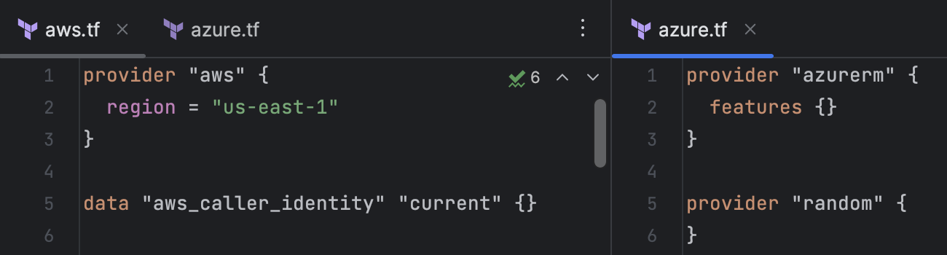
Provider examples
Each provider has options to configure how it interacts with resources.
AWS provider
The region parameter must be set if the AWS_REGION or AWS_DEFAULT_REGION environment variables are not set.
Azure provider
To use the default configuration for Azure resources, use an empty features block.

Slide 10
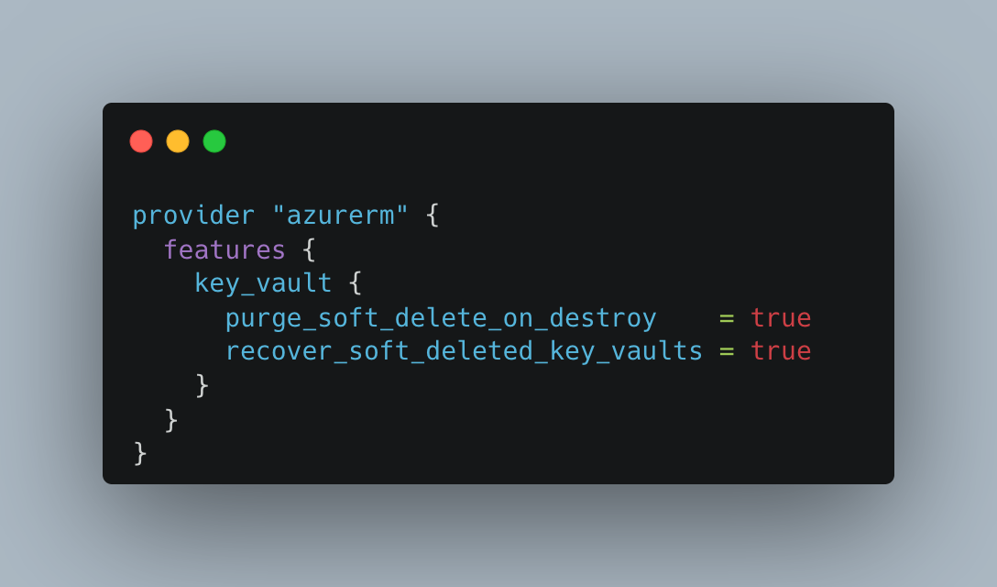
Azure provider example

Slide 11
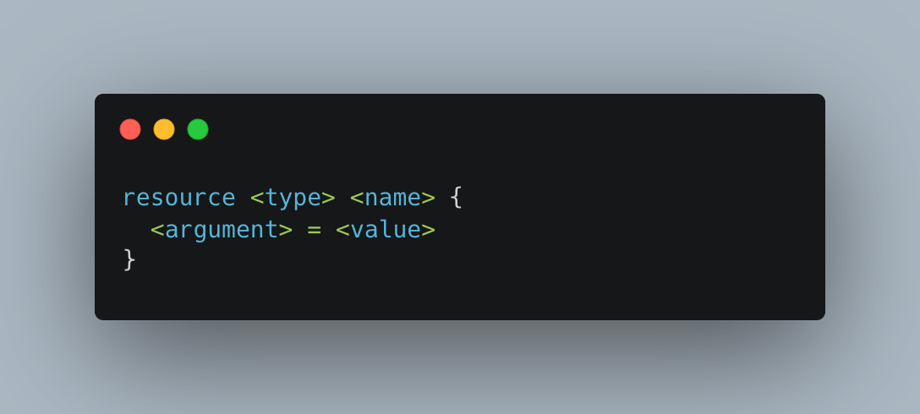
Terraform components: resources
The most important element in a Terraform configuration!
A resource defines one or more infrastructure elements such as a virtual network or compute instances.
Different resources have different arguments to configure. Some are optional while others are required.

Slide 12
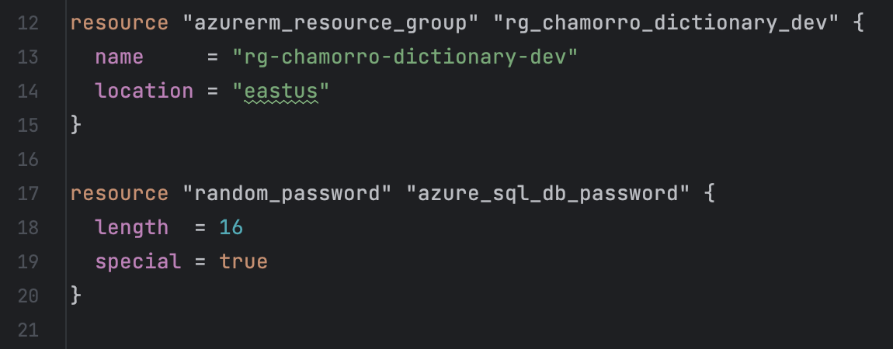
Examples: declaring resources
The azurerm_resource_group defines a resource group called rg-chamorro-dictionary-dev in the East US region of Azure.
The random_password resource comes from the “random” provider and is used to generate a random, sensitive string that contains 16 characters, including special characters.
The “random” provider is a logical provider and works entirely within Terraform logic.

Slide 13
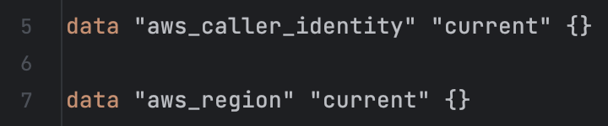
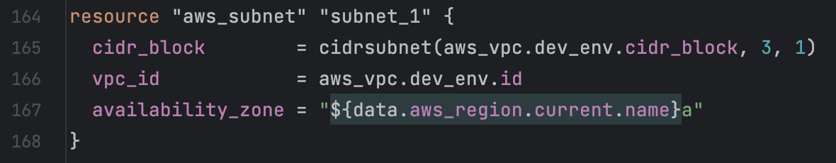
Terraform components: data sources
A data source allows Terraform to use information defined outside of Terraform.
The aws_region data source gets the current region that is configured on the AWS provider.
The name of the region is used to define which availability zone (AZ) the subnet below should be deployed to (us-east-2a).

Slide 14
Terraform components: input variables
An input variable allows customization of Terraform modules without altering the module’s source code.
For example, it can be used to specify which environment to deploy resources into, e.g., Development or Production.

Slide 15
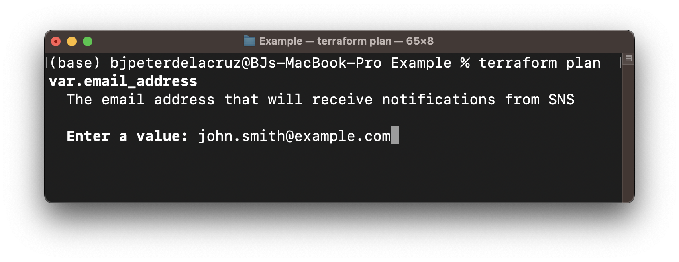
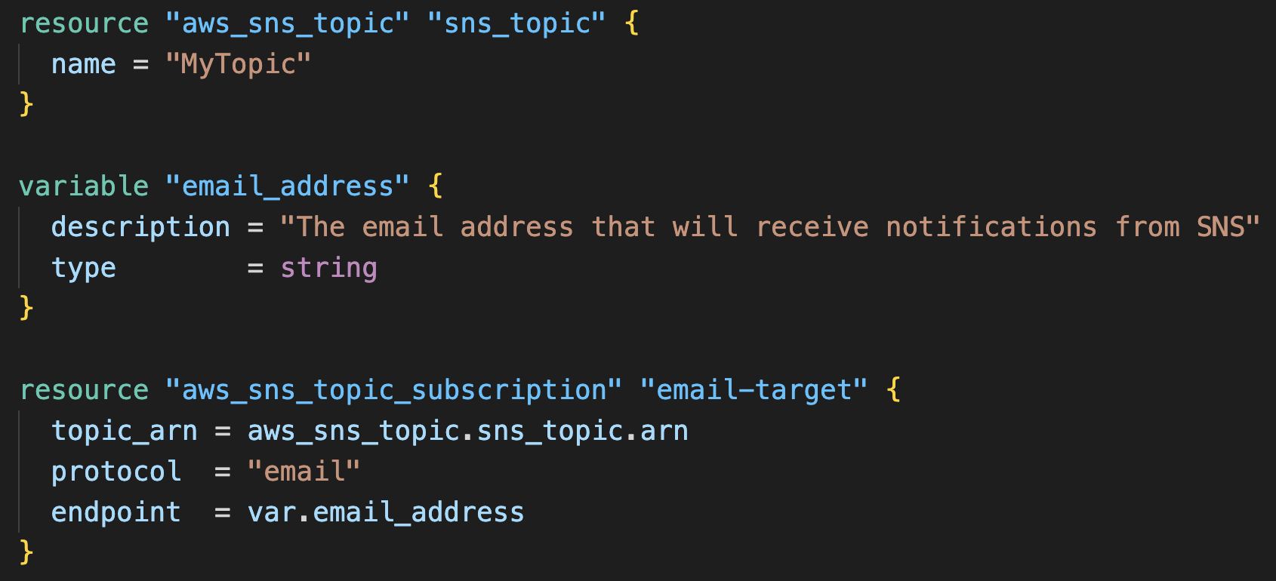
example: input variables
When the Amazon Simple Notification Service topic called MyTopic is deployed, John Smith will be subscribed to it.

Slide 16
Terraform components: outputs
To make information about your infrastructure available on the command line, use output values.
Outputs are rendered when Terraform applies your plan.
Values that are marked as sensitive will not be outputted to the command line.
For example, use outputs to display the endpoint of an API that was deployed to AWS, a random string that was generated using the “random” provider, etc.

Slide 17
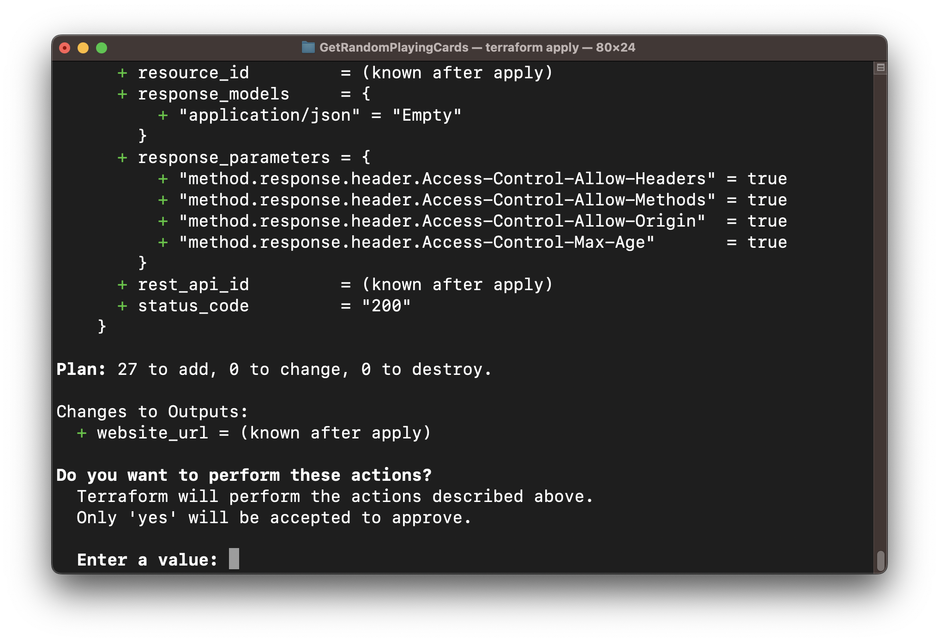
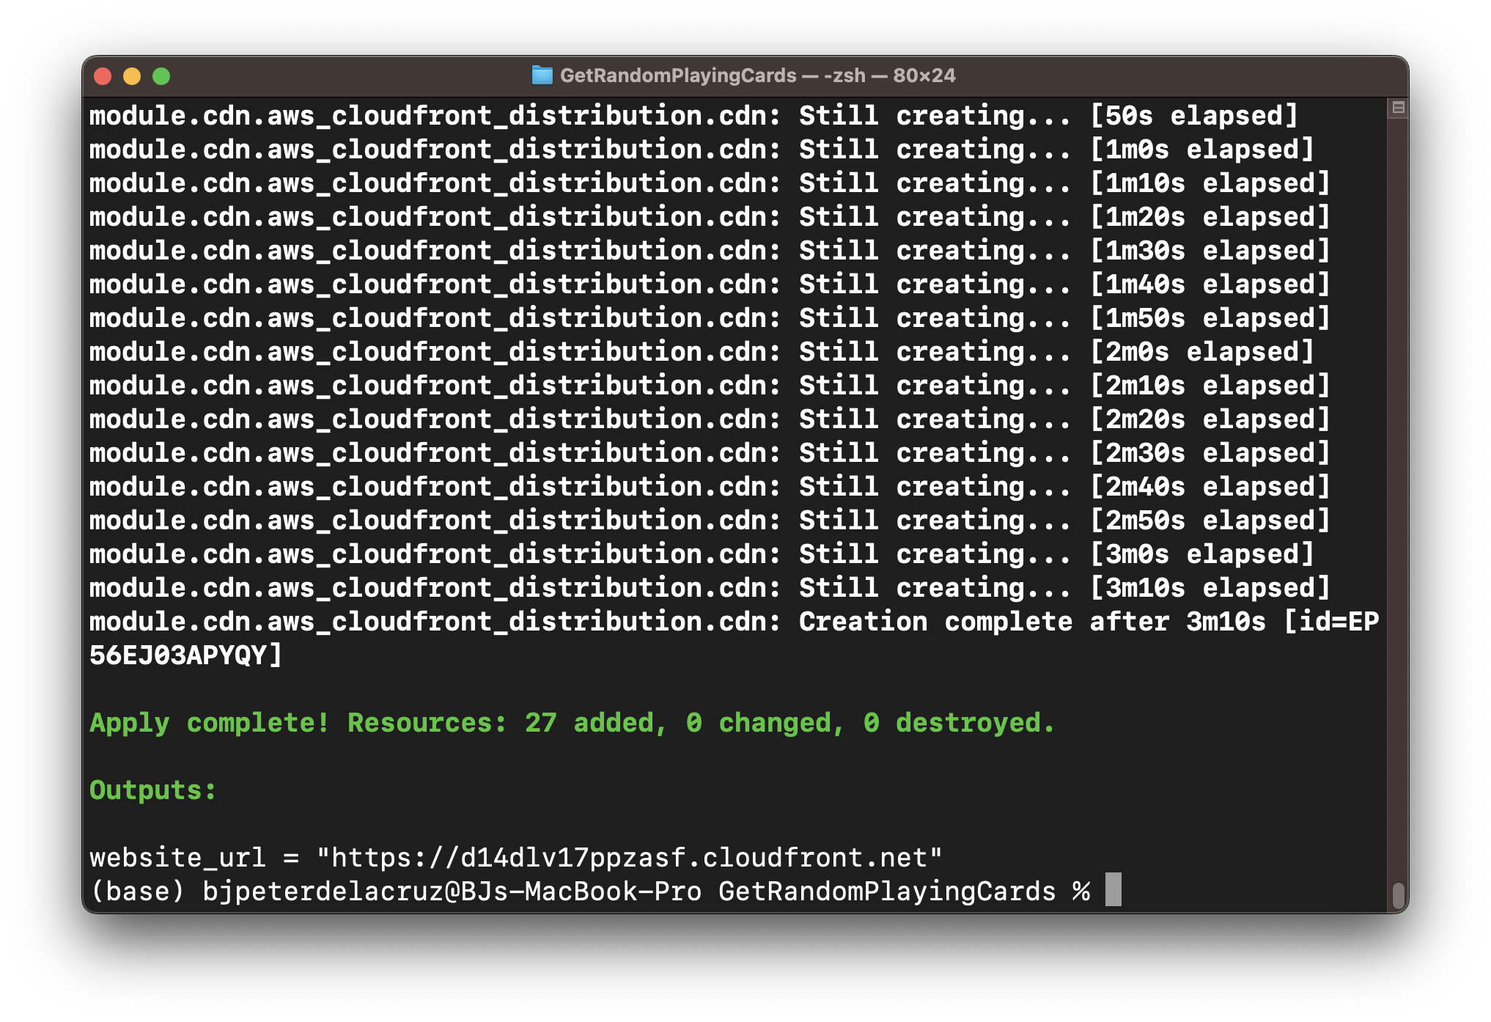
Example: outputs

Slide 18
Terraform components: modules
A module is a container for multiple resources that are grouped together.
Modules are a way to package and reuse configurations.
If you are going to build a collection of serverless applications that use AWS Lambda, Amazon API Gateway, and Amazon DynamoDB, and each of these resources uses a standard or default configuration, then package them into a module so they can be reused in projects.
Every Terraform configuration has at least one module, the root module.
A module can call child modules to include their resources in the configuration.

Slide 19
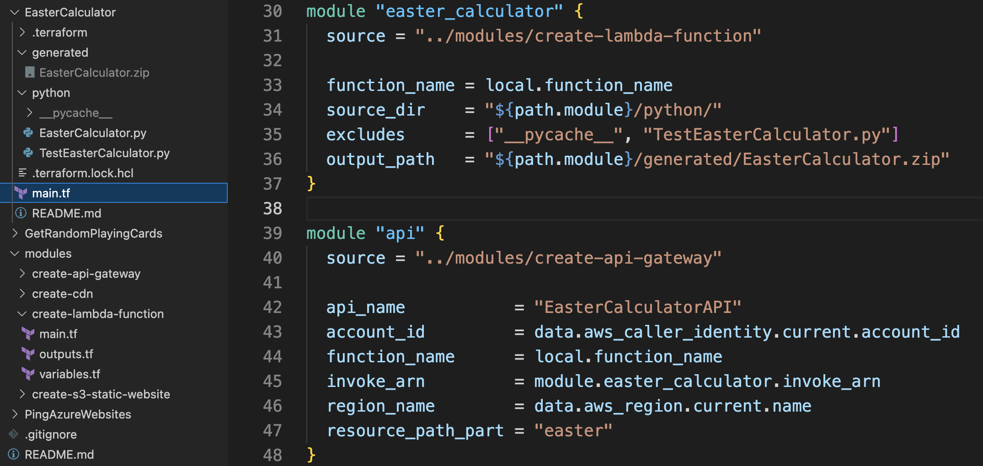
examples: modules

Slide 20
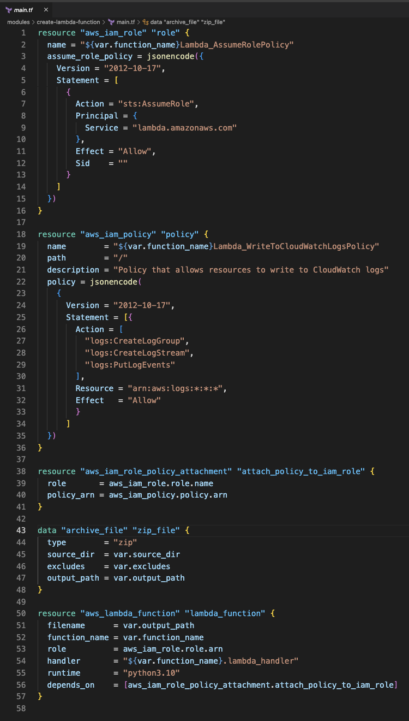
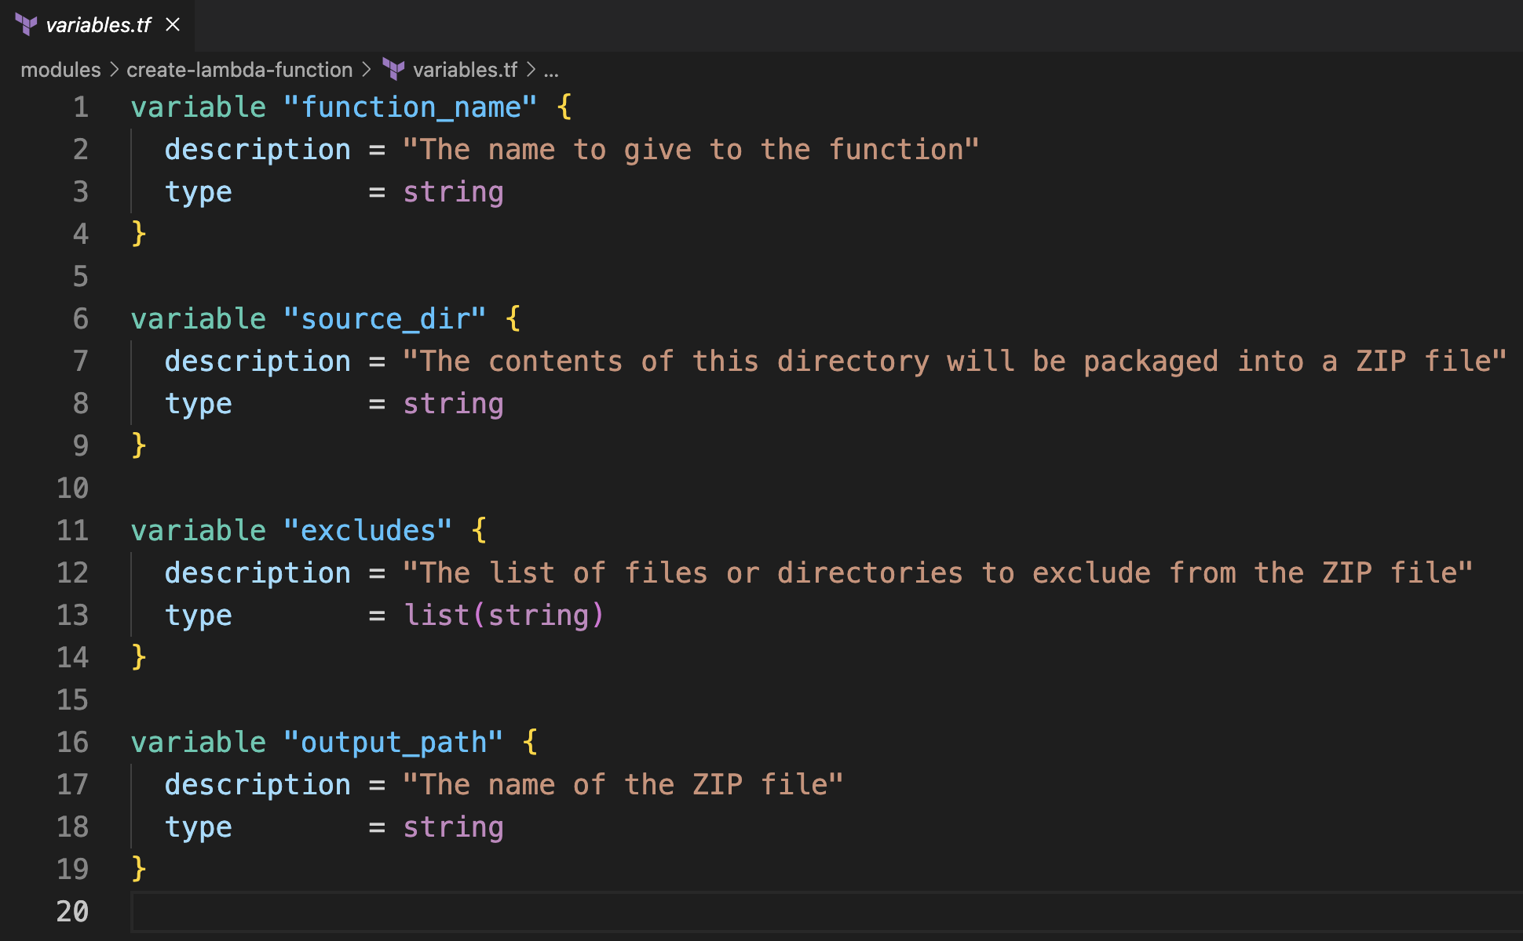
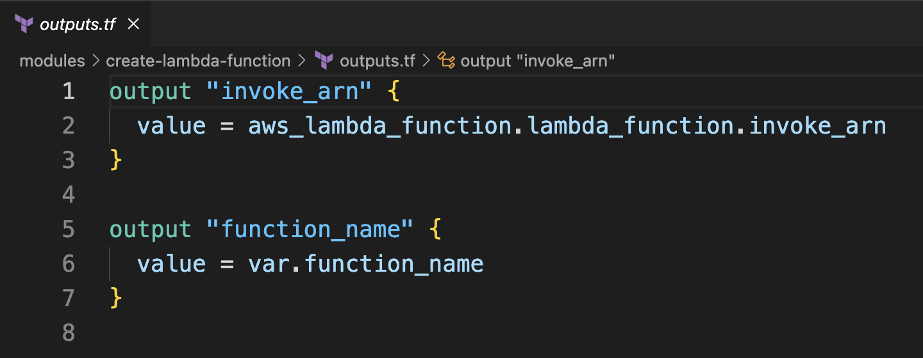
The create-lambda-function module

Slide 21
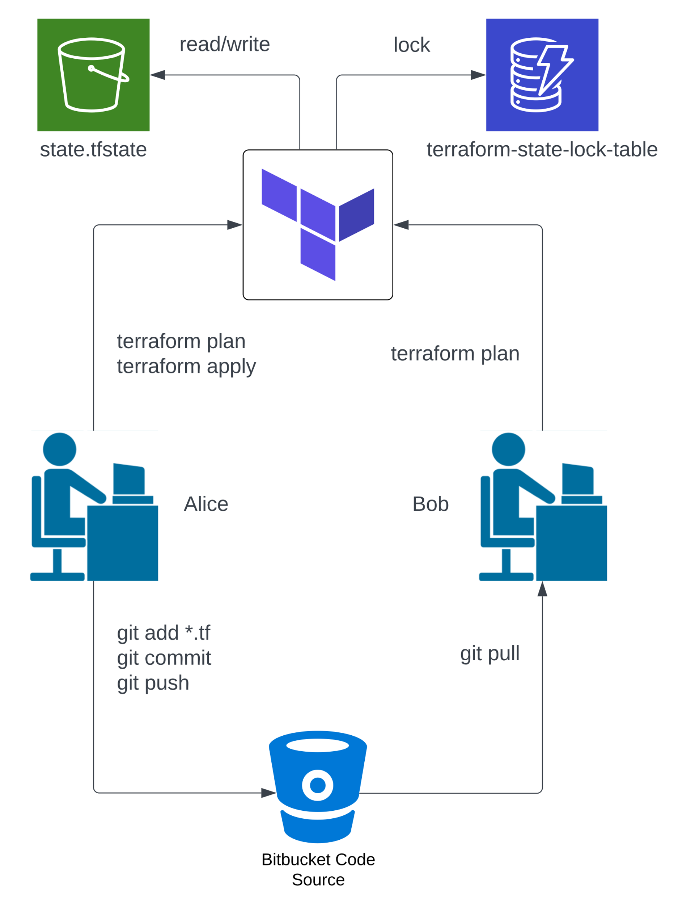
How does terraform keep track of changes to your infrastructure?
Terraform stores information about your infrastructure in *.tfstate files.
These files keep track of resources created by a configuration and map to real-world resources.
You can store these files on your development machine or in a remote storage location such as a Blob Storage account or an S3 bucket.
Use state locking when collaborating with members of your team to avoid conflicts and data corruption.

Slide 22
How does terraform keep track of changes to your infrastructure?
Alice applies changes to the infrastructure using terraform apply and then commits her changes to a remote repository in BitBucket.
Bob has an older version of the configuration, so he pulls in the changes made by Alice (git pull).
When Bob runs terraform plan, he receives the message:
No changes. Your infrastructure matches the configuration.

Slide 23
How does terraform keep track of changes to your infrastructure?
You can use Blob Storage in Azure to store the state file. Blob Storage supports locking through its lease mechanism.
Or you can use an S3 bucket in AWS to store the state file. To lock the state file, you need to set up and configure the IAM permissions for a DynamoDB table.

Slide 24
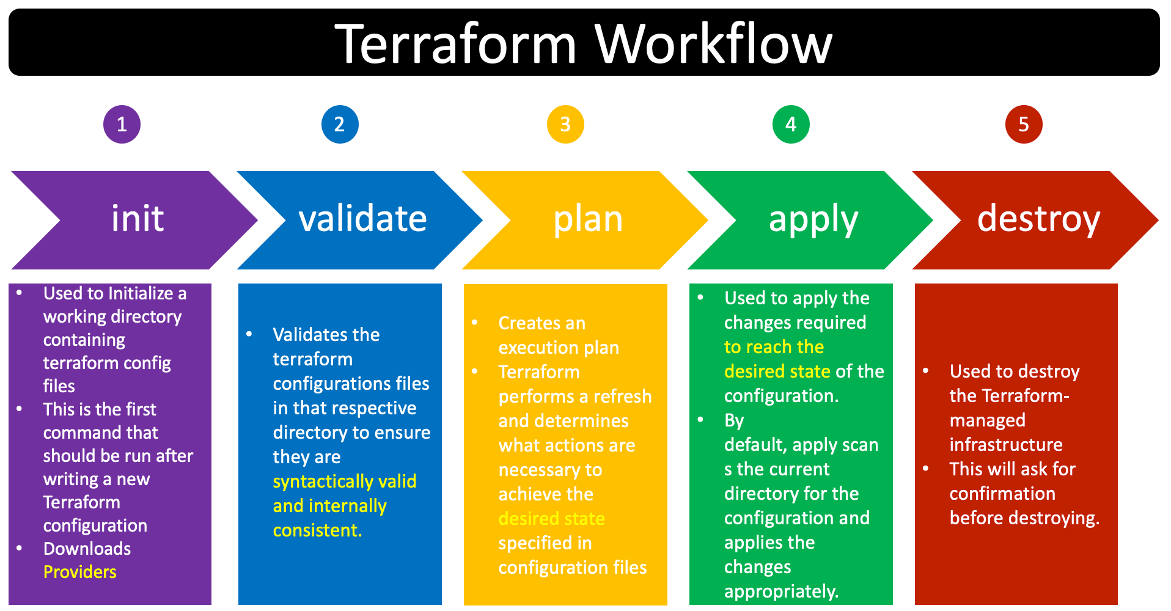
Commands: init, validate, plan, apply, destroy
Source: https://blog.gautamkumar.co.uk/wp-content/uploads/2021/10/terraform.png

Slide 25
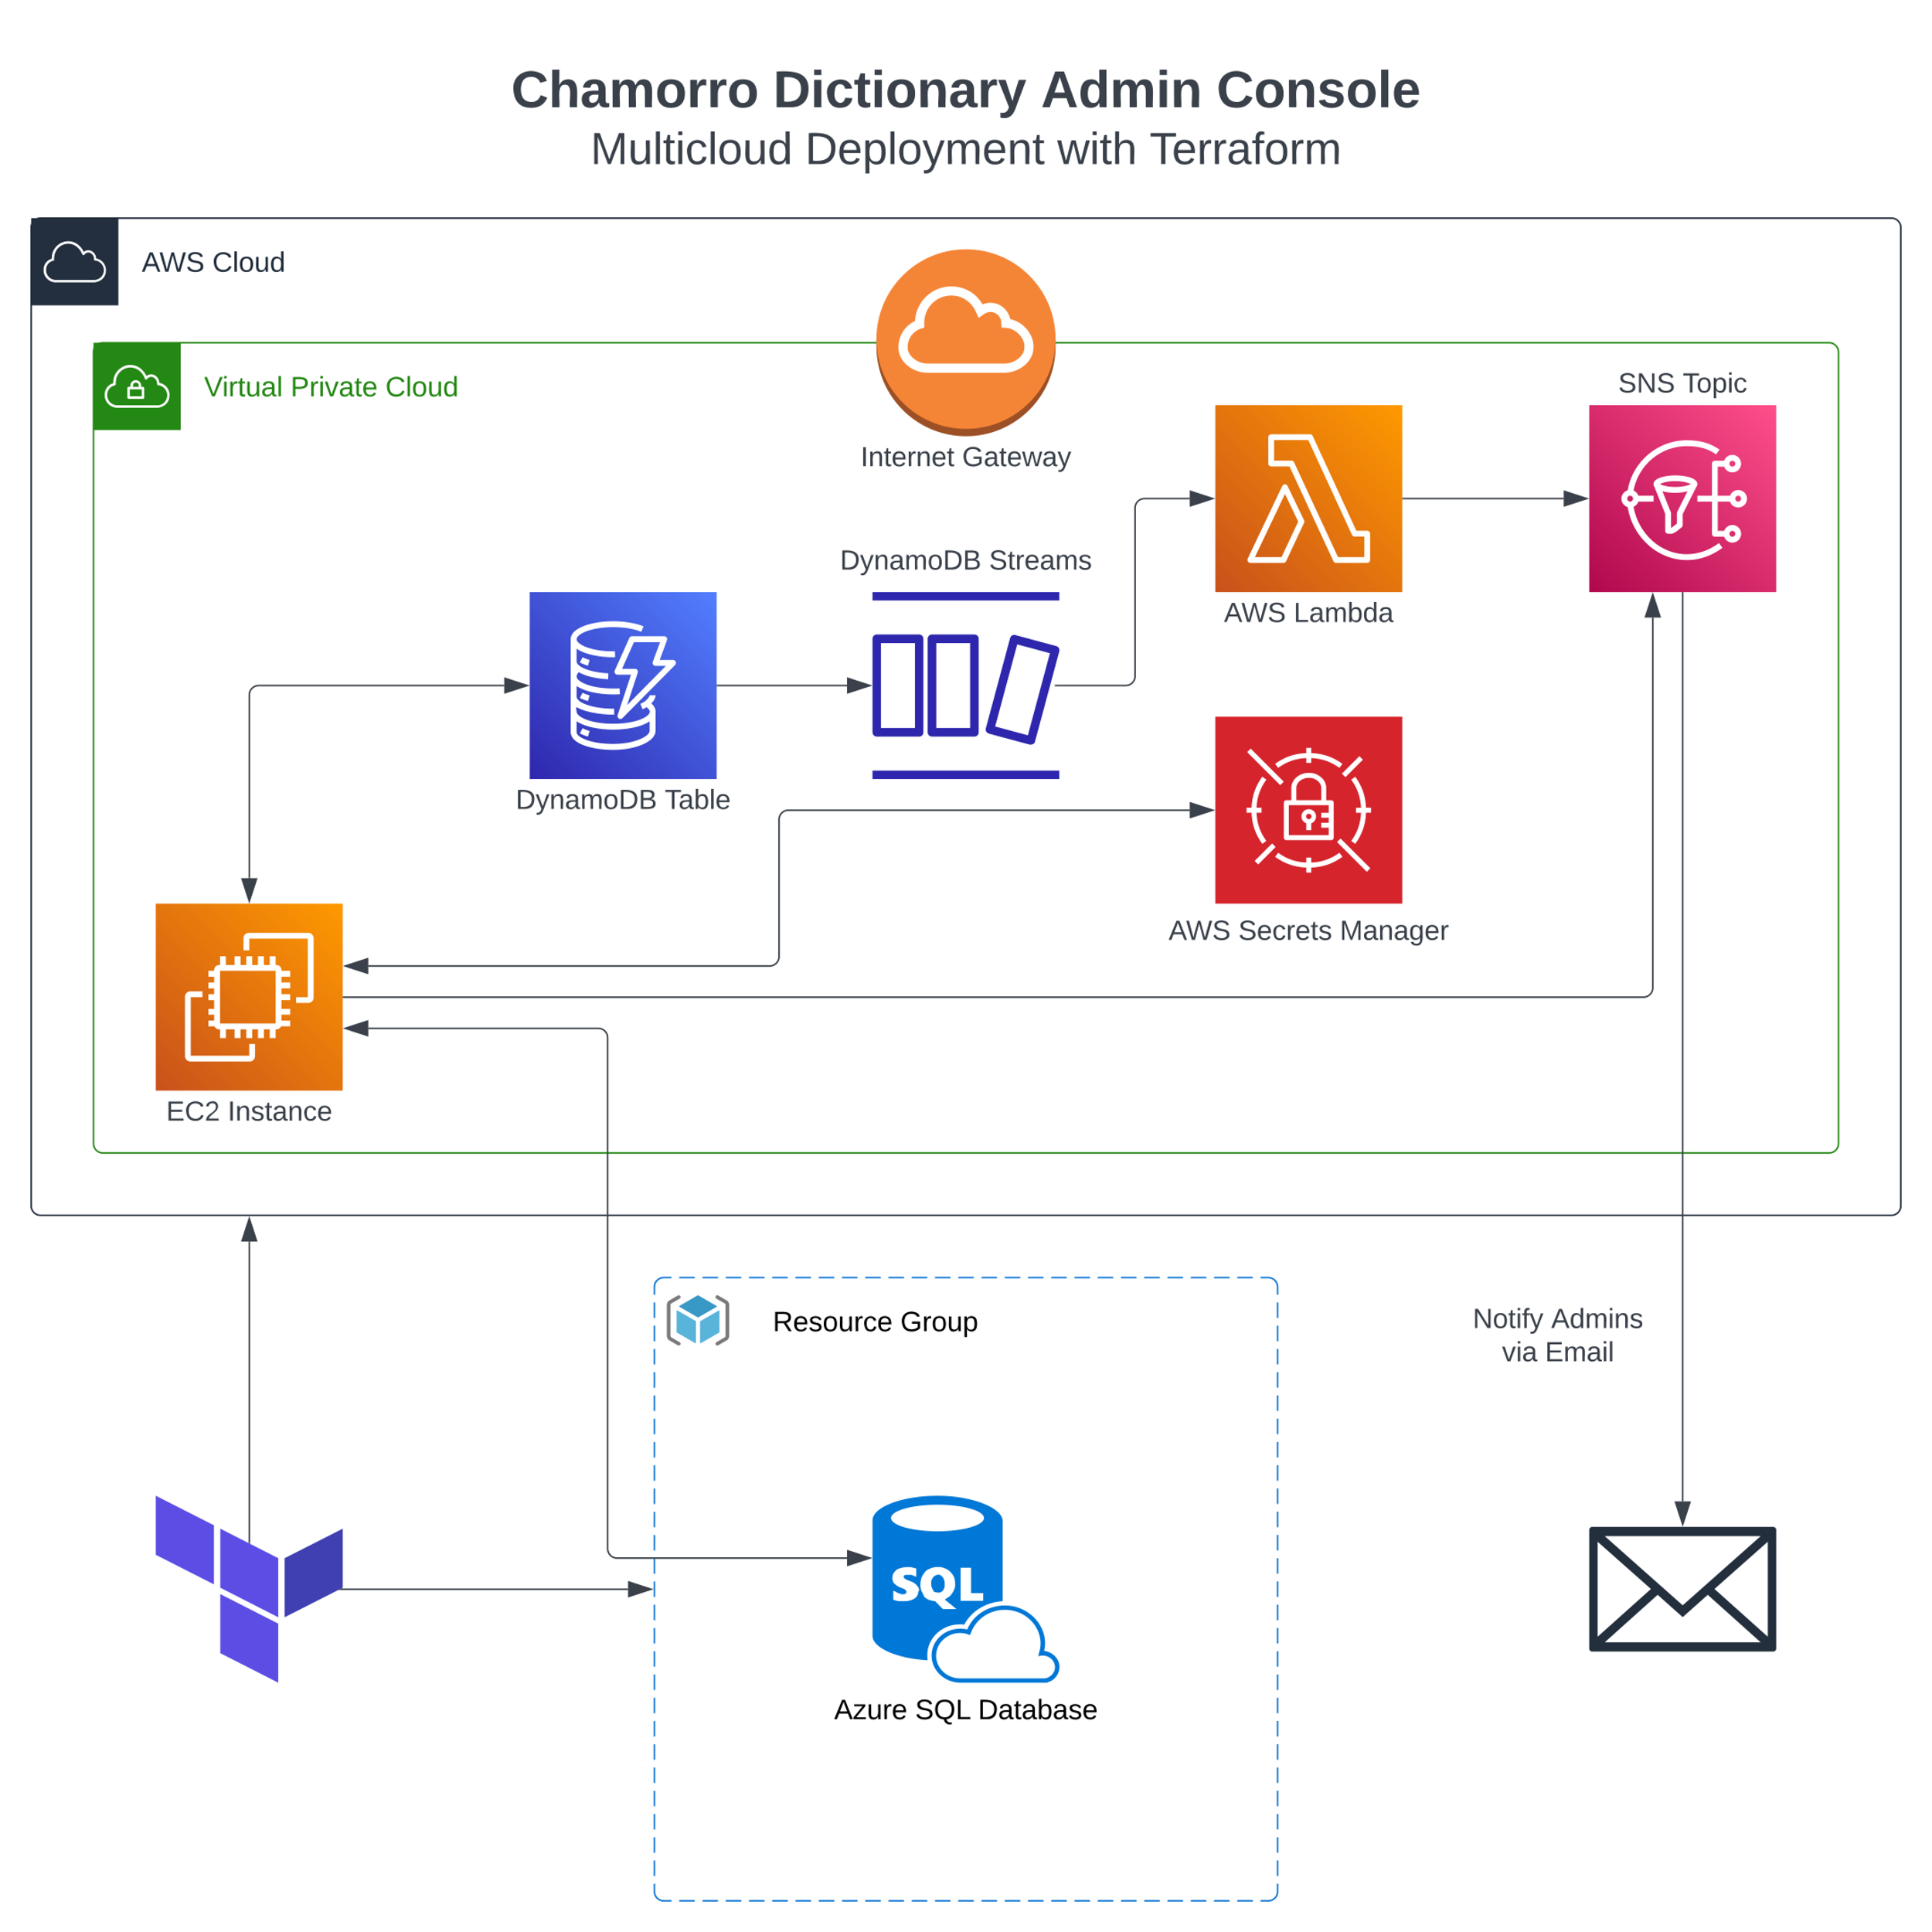
Architecture diagram: chamorro dictionary admin console

Slide 26
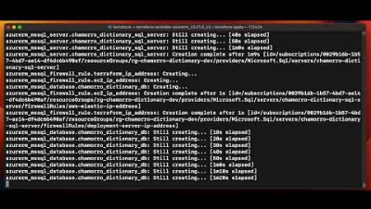
Demo: deploying to aws and azure

Slide 27
Putting it all together
https://bitbucket.org/bjpeterdelacruz/chamorro-dictionary-admin-console/src/master

Slide 28
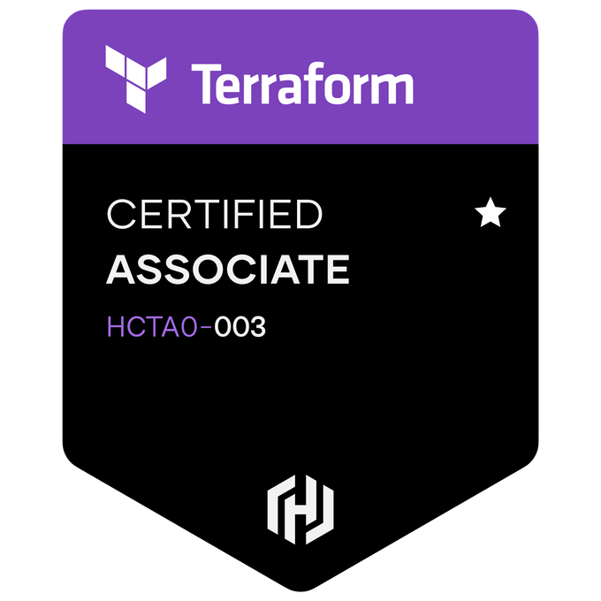
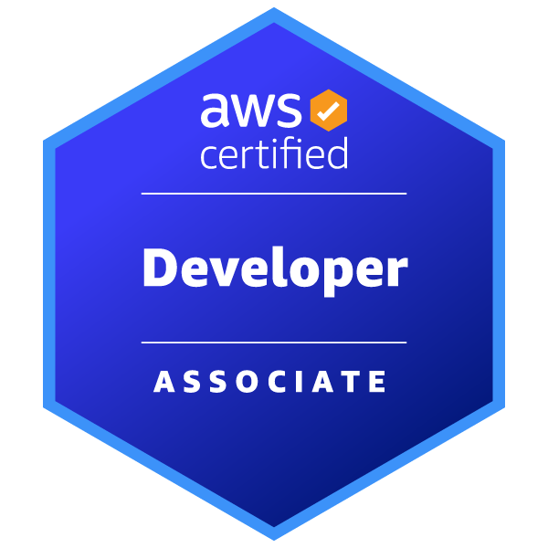

certifications

